Slide 1
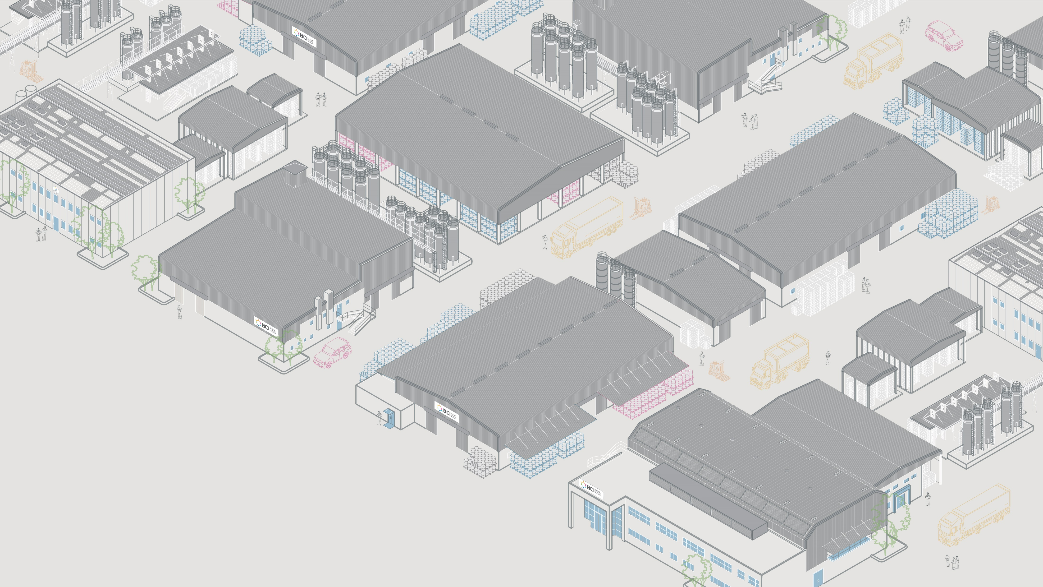


Slide 2
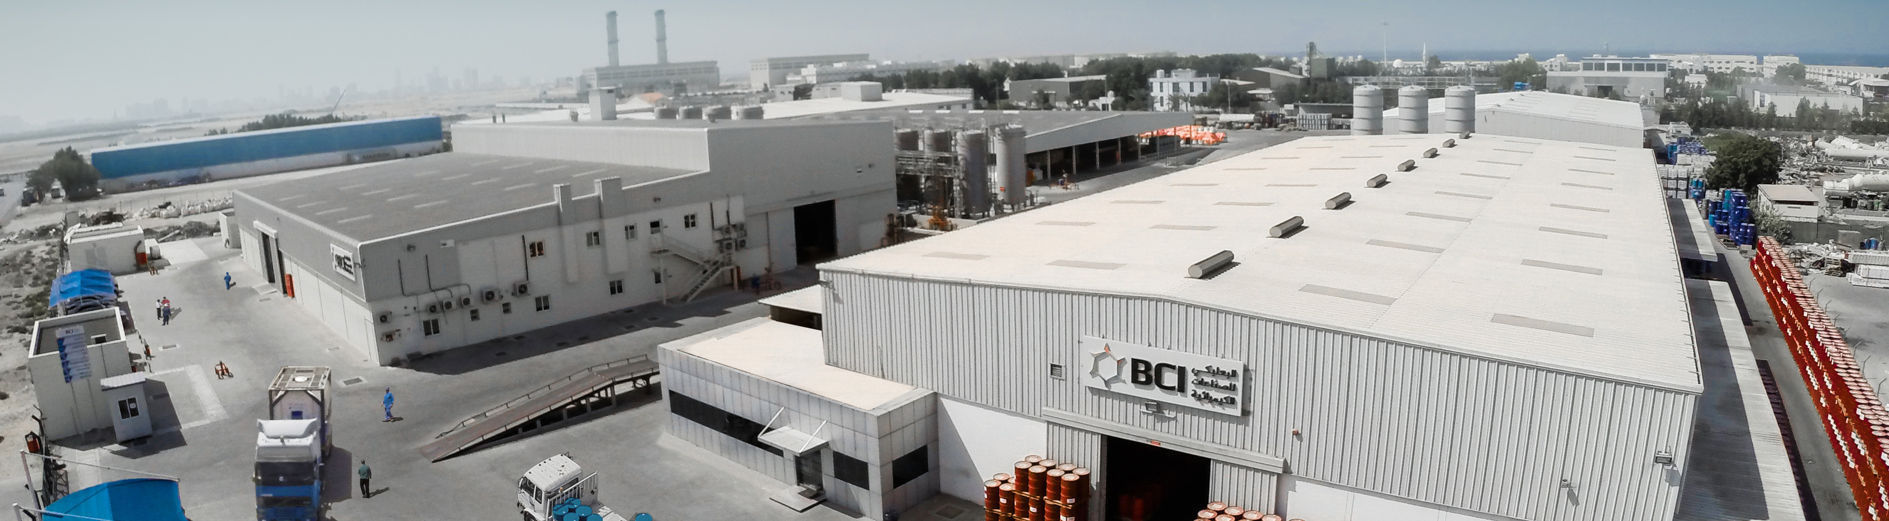

COMPANY PROFILE
Who We Are
Where It All Began
What Guides Us
Our Journey
Industries We Serve
Why it Matters
Our Solutions
Our Unique Position
Our Asset Footprint
Our Network
Leadership & Teams
Governance & Structure
Supervisory Board
Legal Structure
Standards & Certifications
03
05
09
10
12
13
17
19
21

Slide 3
WHERE IT ALL BEGAN
A family legacy dedicated to “business as a force for good” since the late 1800s
Baalbaki Group headquarters are established in Beirut, Lebanon. IMIC and UNIMETCO are founded as key trading and industrial arms.
The Group introduces PU spray foam in the Middle East and is awarded the insulation contract for Queen Alia International Airport in Jordan.
The Baalbaki family is active in industry, trade, and agriculture across the Levant region.
1800’s
1960s
1980s
1950s
1970s
1990s
The Group establishes manufacturing operations producing domestic refrigerators, gas ovens, and steel furniture under license from Mauser GmbH and Linde A.G., Germany.
The Group introduces polyurethane (PU) systems in the Middle East, promoting their application as insulation materials for refrigerators and cold stores.
Polyurethane became one of the Group’s core businesses, setting the for the start of BCI’s journey and its emergence as a regional industry leader.

Slide 4
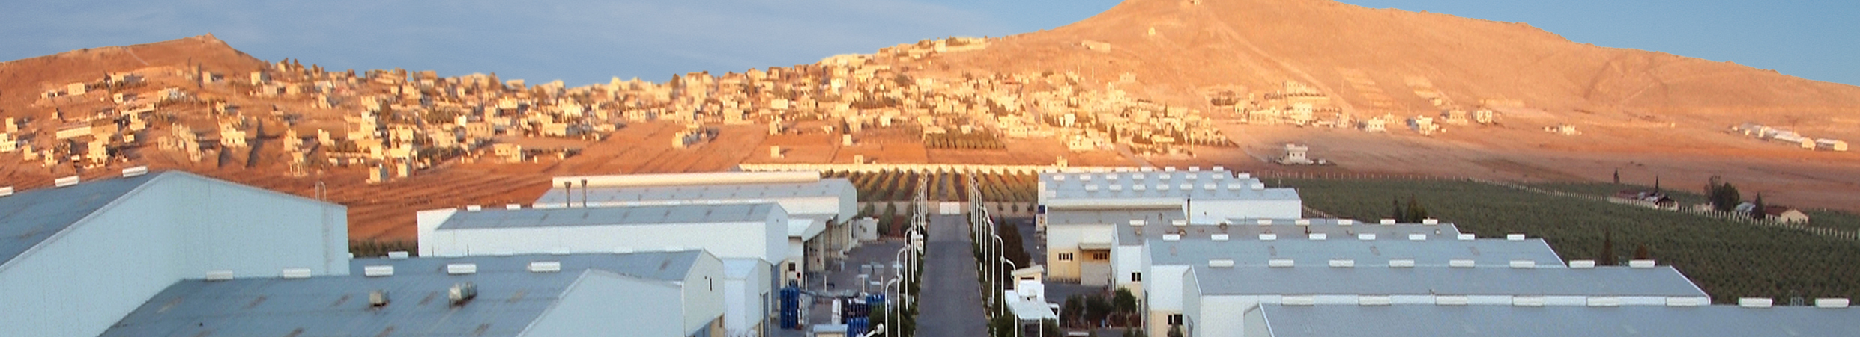
WHAT GUIDES US
The values that shape our DNA and guide our ambition and purpose
Our Values
Our Vision
Our Mission
Humility and Perseverance
Integrity and Transparency
Prudent Entrepreneurship
Financial Discipline
BCI aims to become a global player in the polyurethane solutions industry recognized for its consistent product quality, its exceptional human resource capability, its customer focus, and its commitment to the local communities where it operates.
BCI is to be the EMEA region’s leading and preferred supplier of PU systems, polyester polyols, and PU specialties through a solid commitment to product leadership, operational excellence and customer intimacy.

Slide 5
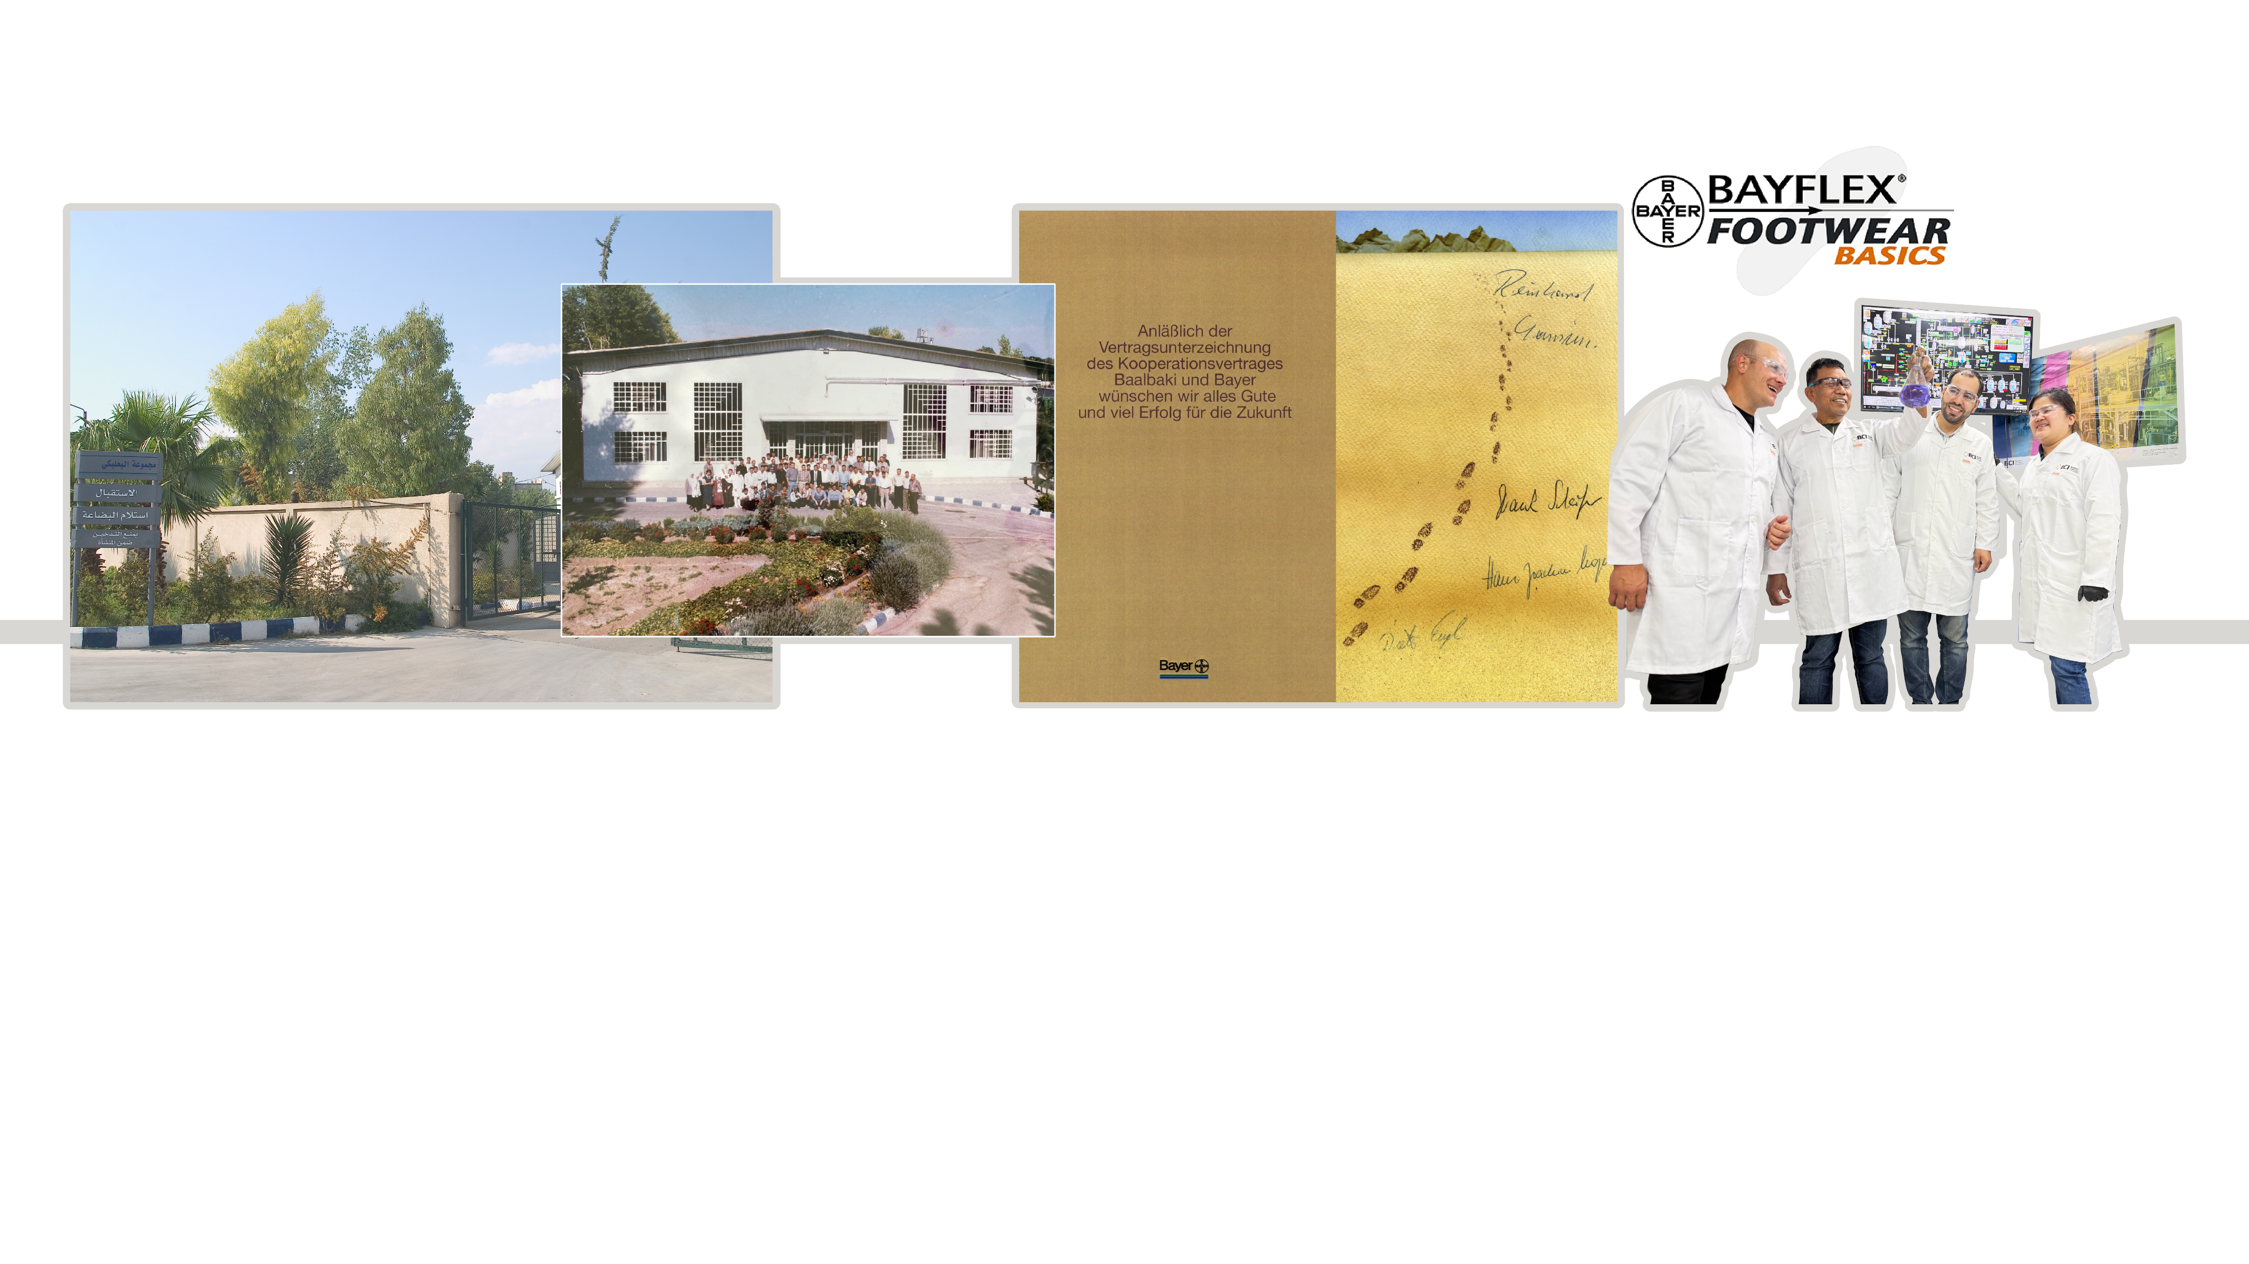
OUR JOURNEY
From introducing European cutting-edge technologies to the middle east polyurethane markets…
1994
1998
1999
2000
2004
Established the first PU system house in the Middle East region with prepolymer technology.
Signed a Supply and Technical Support Agreement with Bayer A.G. Germany and organized the first Middle East Polyurethane Symposium.
Awarded the Bayer AG Award for sustainable partnerships.
Signed a Trademark Licensing Agreement with Bayer AG Germany.
Established BCI Holdings S.A. with the aim of setting up a network of PU system houses in the EMEA region.
Watch Our Journey:
Our Origins
Where We Are
Where We Are Heading

Slide 6
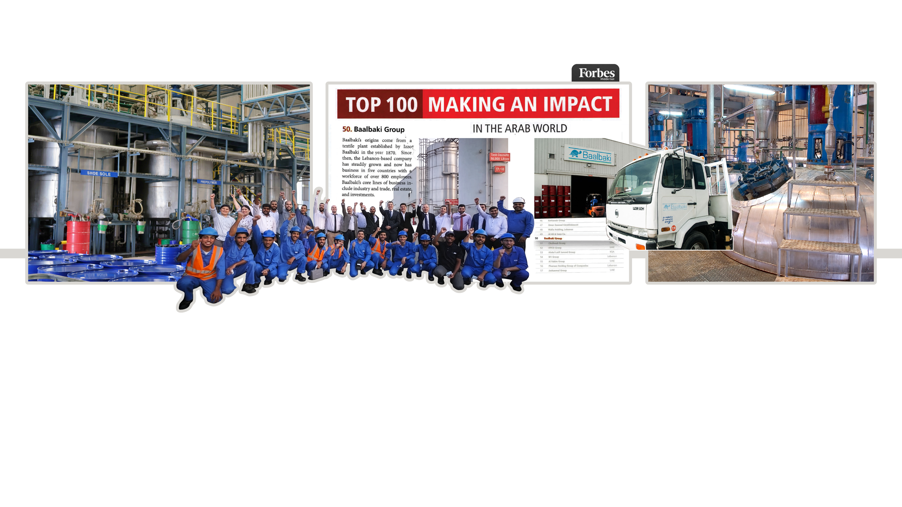
OUR JOURNEY
To becoming the leading and preferred supplier of PU systems in the Middle East…
2005
2008
2010
2012
2013
Established a polyurethane system house in Hamriyah Free Zone, UAE, to serve the GCC markets.
Launched a polyurethane system house in 6 of October, Egypt, to serve the Egyptian and African markets.
Acquired Depur Kimya Turkey and established BCI Türkiye AS, a distribution and technical service center for polyurethane systems to serve the Turkish market.
Recognized by Forbes magazine as one of the top 50 companies making an impact in the Arab World.
Inaugurated a plant for the production of polyester polyols, isocyanate prepolymers, and flexible packaging adhesives in Egypt.

Slide 7
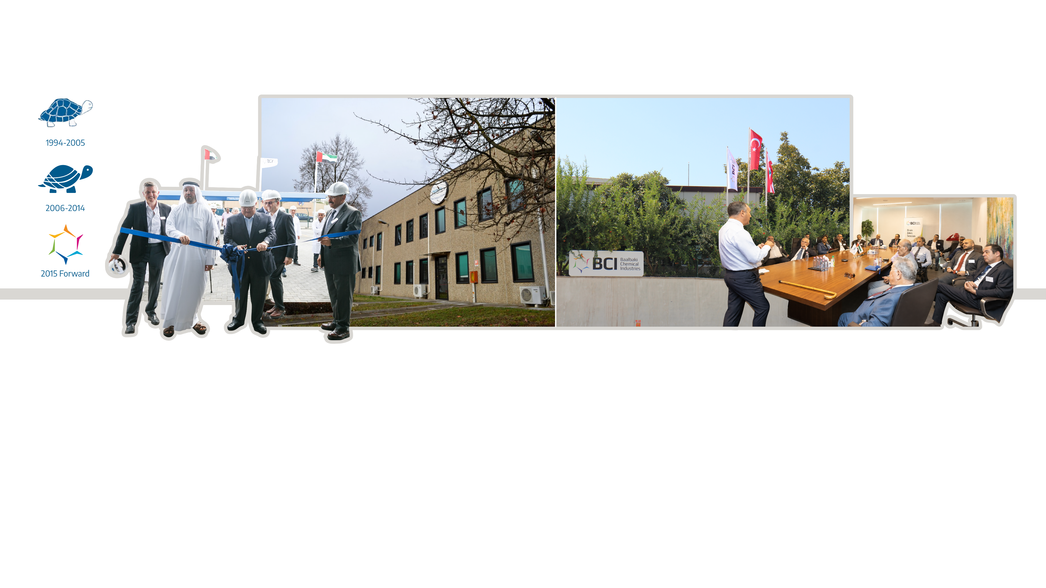
OUR JOURNEY
To growing into Europe and Türkiye, expanding our specialties portfolio, and shifting our HQ to the GCC…
2015
2016
2018
2020
Introduced the evolved “turtle” as part of BCI’s new corporate identity.
Inaugurated a new production facility for polyester polyols, isocyanate prepolymers, and flexible packaging adhesives with a state-of-the-art R&D center in the United Arab Emirates.
Acquired a majority stake in Polysystem Srl, an Italian producer of PU systems, and established BCI Europe Srl to serve the European polyurethane systems market.
Commissioned the first flexible packaging adhesives manufacturing facility in Mersin–Tarsus Industrial Zone, Türkiye
Incorporated UNIMETCO Holdings Ltd. in the Dubai International Financial Centre (DIFC) and moved BCI Headquarters to the UAE.

Slide 8
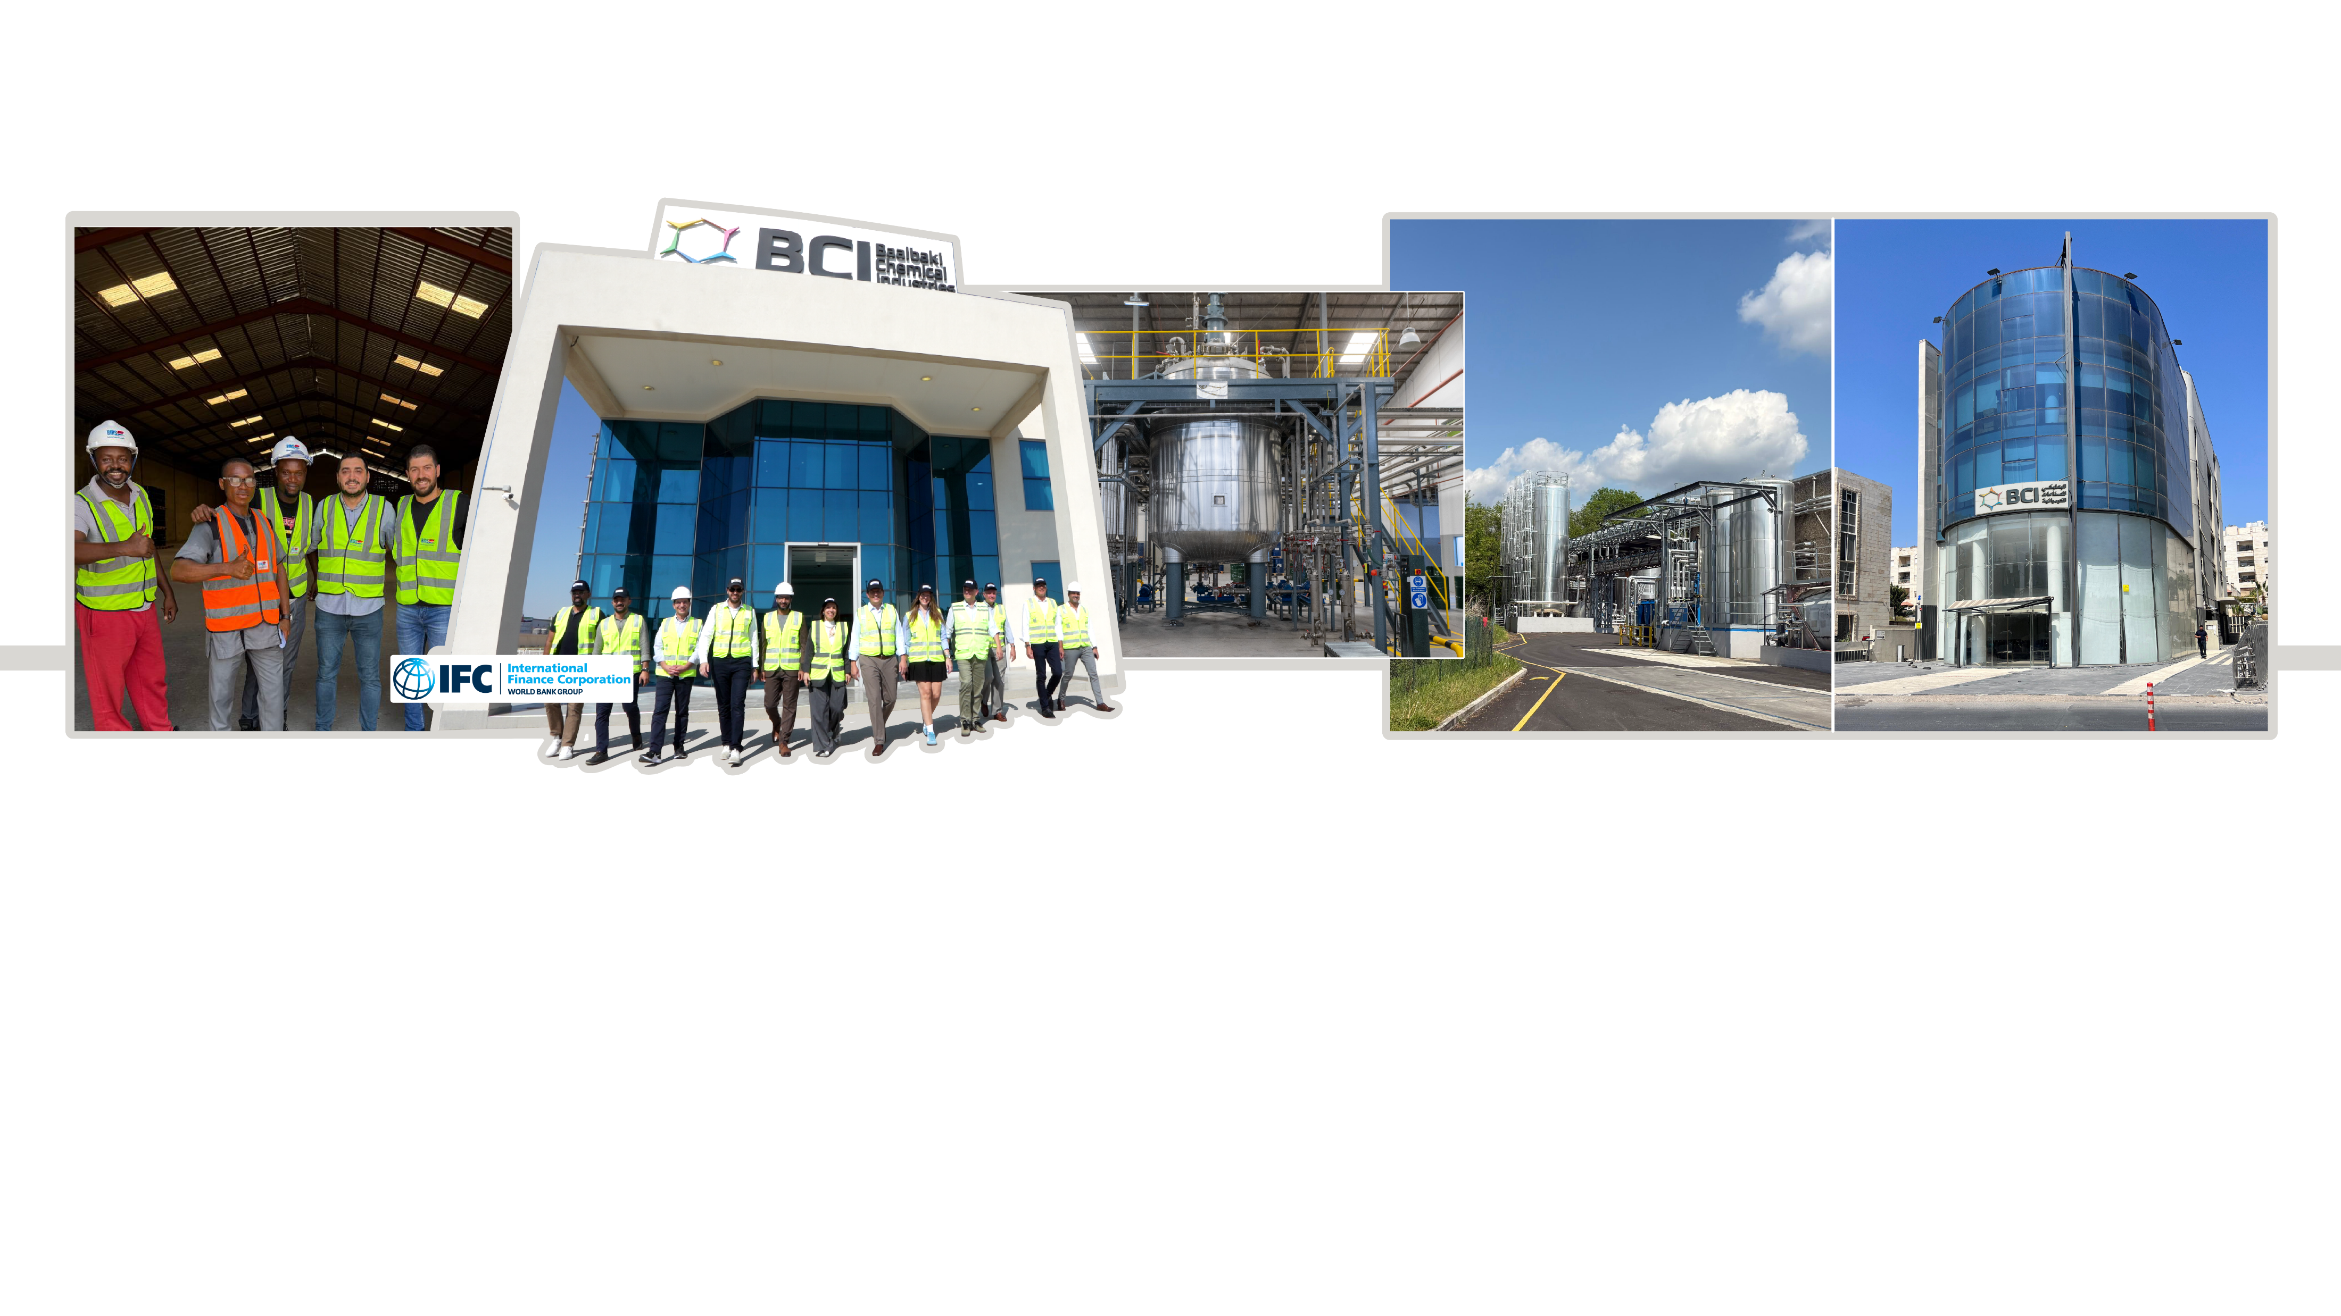
OUR JOURNEY
To setting the path towards exporting home grown Middle Eastern PU technology and business best practices the world…
2021
2022
2024
2025
Set up a distribution center in Nigeria to better serve the African markets.
IFC partnered with BCI Holding SA through a USD 30 million medium-term loan to finance the company’s expansion plans in Egypt, Nigeria, and Türkiye, supporting job creation and circular economy initiatives.
Acquired BASF Kanoo LLC Dubai, BASF’s GCC Polyurethane business headquartered in Dubai Industrial City (DIC).
Established BCI Arabia and built a state-of-the-art system house for downstream polyurethane systems in Riyadh, serving the KSA market and contributing to the goals of Saudi Vision 2030.
Upgraded its system house and bulk storage facilities in Vedano Olona, Italy with state-of-the-art technology, and converted the plant to operate on solar energy.
Established BCI Jordan, a distribution and technical service center, to support the development of the Jordanian market.

Slide 9
INDUSTRIES WE SERVE
Through customer proximity and technical intimacy, we help develop industries across the various verticals we serve
Construction Appliances Adhesives Furniture & Bedding Automotive Footwear Others
Construction Appliances Adhesives Furniture & Bedding Footwear Technical Insulation & Decoration
Global Polyurethane Market
Industries
We Serve

Slide 10
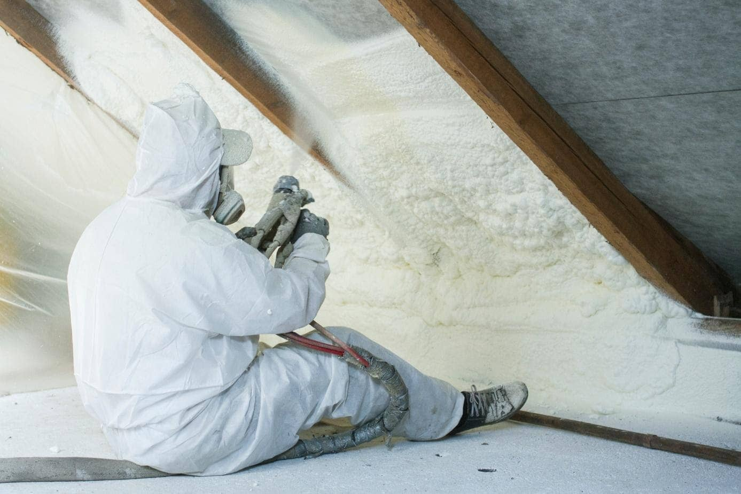

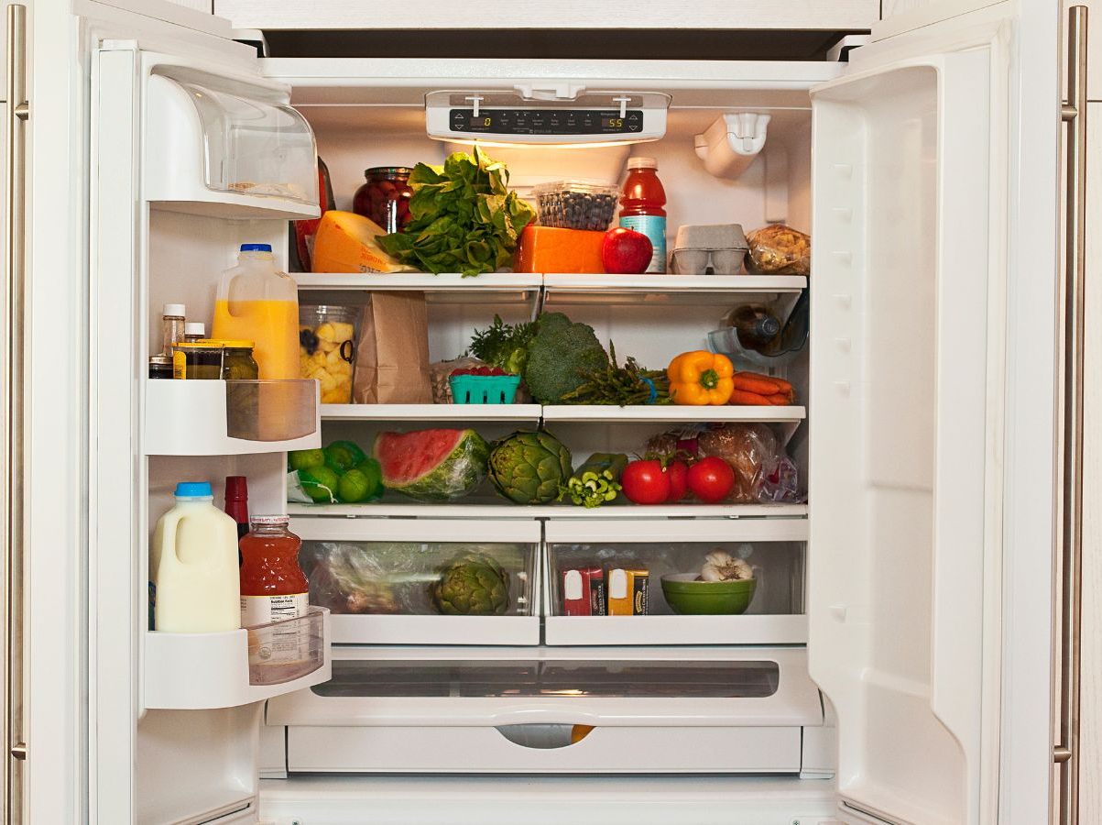
WHY IT MATTERS
Polyurethane raw materials and systems enable other downstream industries and promote meaningful job creation
What Are Polyurethanes & Why They Matter
A highly adaptable polymer family that can be tailored into durable and versatile foams, elastomers, coatings, adhesives, and sealants.
A USD 80+ billion global industry, touching nearly every manufacturing segment and still expanding worldwide.
Typically grows at 1.5–2× global GDP—benefiting from megatrends such as urbanization, construction spending, cold-chain expansion, furniture, and mobility.
Used across thousands of applications spanning construction, automotive, furniture & bedding, appliances, textiles, electronics, medical, packaging, footwear, and more.
Critical enabler of everyday living—improving energy efficiency, comfort, safety, and durability.

Slide 11
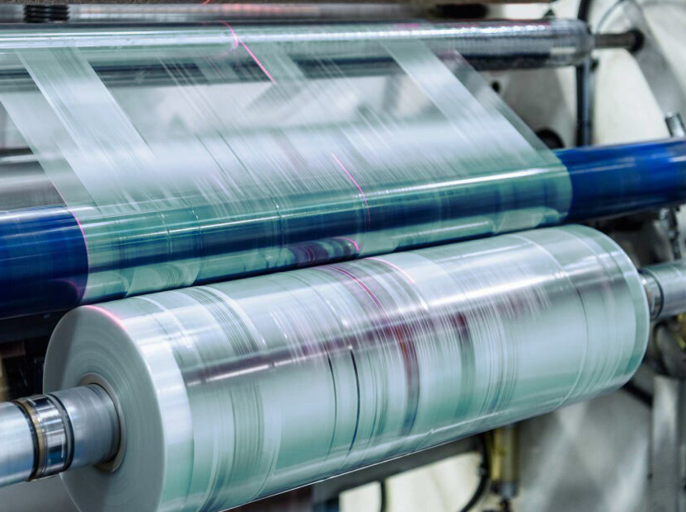
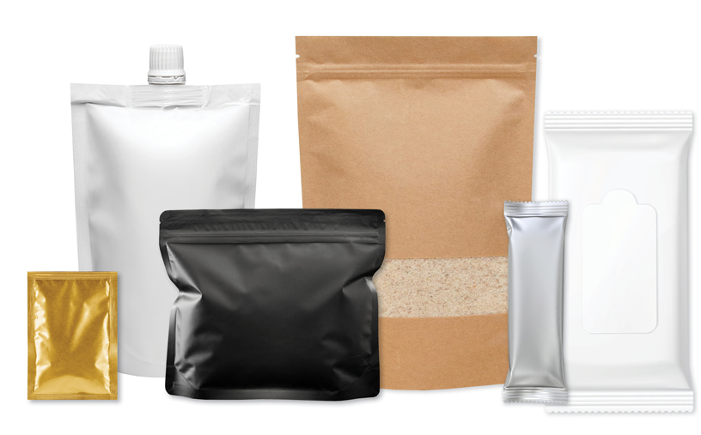
WHY IT MATTERS
Adhesives that promote safe packaging of consumer goods and enable local food security
What Are Flexible Packaging Adhesives & Why They Matter
Specialized polymers that combine the performance features of two or more different films, foils, and papers into durable, lightweight packaging.
A USD 5–6 billion global market, projected to exceed USD 8 billion by 2033.
Expanding at a steady ~5–6% CAGR, slightly outpacing global GDP.
Used in thousands of applications across food, pharma, e-commerce, and consumer goods.
Critical for food safety, product preservation, consumer appeal, packaging efficiency, and sustainability.

Slide 12
OUR SOLUTIONS
A comprehensive product range built on expertise in supplying raw materials to industries and our passion for PU chemistry
®™
PRODUCT GROUP | SUBGROUP | BCI BRAND | MAJOR APPLICATIONS
PU Systems | PU Rigid Systems | POLYREX – PROMOL | Continuous & discontinuous panels; appliances; block foam; ducts; window shutters; wood imitation; etc.
 | PU Flexible Molded Systems |  | Office furniture; auto parts; Visco elastic memory foam; rebounded foam
 | Panel Glue | STYROBOND | Adhesives for PIR, EPS/XPS and Rockwool Panels Adhesives for PIR, EPS/XPS and Rockwool Panels
 | Additives | ADDREX - TEMOL; TEMFLAME | Various additives for PU systems
Flexible Packaging Adhesives | Solvent Less | ECOLAD SL | Standard, medium and high-performance solvent less adhesives for flexible packaging
 | Solvent Base | ECOLAD SB | Standard, medium and high-performance solvent base adhesives for flexible packaging
Footwear Systems | PU Footwear Systems | POLYREX | PU Systems for the production of soles, slippers, fashion, casual, sport ,and safety shoes
 |  | ISOREX - ISOTEM
 |  | CROSSREX
 | Additives | ADDREX | Agents for cleaning, curing, and crosslinking
Polyester Polyols | Aromatic | PUROL | Rigid PU foam
 | Aliphatic | BASIS | CASE and PU flexible slabstock
Coatings, Adhesives & Sealants Raw Materials | Coatings Prepolymers | ISOREX RC | Rubber and cork granule binder; sports flooring systems
 | High MW Polyester Polyols | POLYMELT | Specialty binders for various applications
Auxiliaries | Polyurea | POLYCOAT | Various coatings
 | Catalyst | AMINOREX - TEMCAT | Various applications
 | Pigments/Master Batch | MATREX | Coloring master batch for footwear and flexible foam
 | Release Agent | SILOREX | Mold release agent for molded PU foam
 | Silicone Surfactant | ADDREX | Silicone Surfactant for flexible and rigid foam
Trading Raw Materials | Polyether Polyols | EPOL | Continuous and discontinuous flexible foam
 | TDI | ISOREX
®
®
™
™
®
®
®
®
®
™
®
™
™
™
™
™
™
™
™
®
™
™
™
™
™

Slide 13
OUR ASSET FOOTPRINT
EMEA's leading independent producer of polyurethane systems, polyester polyols, specialty adhesives & prepolymers...
Capacity to produce
>
MT/annum
legal entities
>
>
drums, IBCs & storage capacity
different nationalities
>
>
team members
countries served

Slide 14
OUR ASSET FOOTPRINT
With a unique asset footprint securing supply consistency, customer service, and customer-driven innovation...
System Houses
Technical Service Centers
Logistic Centers
UAE (Dubai & Sharjah), Egypt, KSA, Italy, and Türkiye
Nigeria and Jordan.
UAE (Dubai, Sharjah), Egypt, KSA, Italy, Türkiye, Nigeria, and Jordan.
Polyester Polyols Plants
Prepolymer Plants
UAE (Sharjah) and Egypt
UAE (Sharjah), Egypt, and Türkiye
MT/annum bulk store capacity

Slide 15
OUR NETWORK
And a unique network of production plants, system houses, and distribution centers across 3 continents and 8 countries
NETHERLANDS
Bulk Storage
ITALY
Manufacturing Facility
TÜRKIYE
Manufacturing Facility
LEBANON
Representative Office
JORDAN
Technical Service
& Distribution facility
EGYPT
Manufacturing Facility
UAE
Manufacturing Facility
KSA
Manufacturing Facility
NIGERIA
Technical Service
& Distribution facility

Slide 16








OUR NETWORK
The proximity that guarantees intimacy
Baalbaki Chemical Industries LLC
Saih Shaib 4, Dubai Industrial City (DIC) 3,
Dubai, United Arab Emirates.
Tel: (+971) 6 526 0788
Baalbaki International FZE
Plot 1 J 22, Hamriyah Free Zone. P.O. Box
42448 Sharjah, United Arab Emirates.
Tel: (+971) 6 526 0788
Baalbaki Egypt for Chemical Industries S.A.E.
Plot 178, Street no. 64, First Industrial Zone, 6th of October City, Egypt.
Tel: (+20) 238 200 136
BCI Arabia Company LLC
Al Kharj Old Road, 2nd Industrial City, Riyadh, Kingdom of Saudi Arabia.
Tel: (+966) 59 712 8469
BCI Polyurethanes Europe Srl
Piazzale Ernesto Cocchi 22, 21040 Vedano Olona (VA), Italy.
Tel: (+39) 332 404 225
UNITED ARAB EMIRATES
EGYPT
KINGDOM OF SAUDI ARABIA
ITALY
TÜRKİYE
NIGERIA
JORDAN
LEBANON
BCI Baalbaki Kimya San. ve Tic. A.S.
Burhan OSB mah. 3. Cad, no9,
Akdeniz, Mersin,
Postal code 33290, Türkiye.
Tel: (+90) 324 502 84 45
Baalbaki Chemical Industries BCI Nigeria Limited
Abule Osun, Along Muwo-Tedi, Tedi Village, Amuwo Odofin, Lagos, Nigeria.
Tel: (+234) 705 200 7000
Avalon Jordan LLC,
Baalbaki Bldg. no. 8,
Bayader Wadi Alseer , Al Sinaah Amman, Jordan.
Tel. (+962) 79 818 8537
BCI Holding S.A. Beirut Rep Office
Baalbaki Building, 6th Floor, Abdel Aziz
Street, Beirut, Lebanon.
Tel: (+961) 1 347 616
Baalbaki Egypt for Chemical Industries
S.A.E. Beirut Rep Office
Baalbaki Building, 4th Floor, Abdel Aziz
Street, Beirut, Lebanon.
Tel: (+961) 1 353921

Slide 17
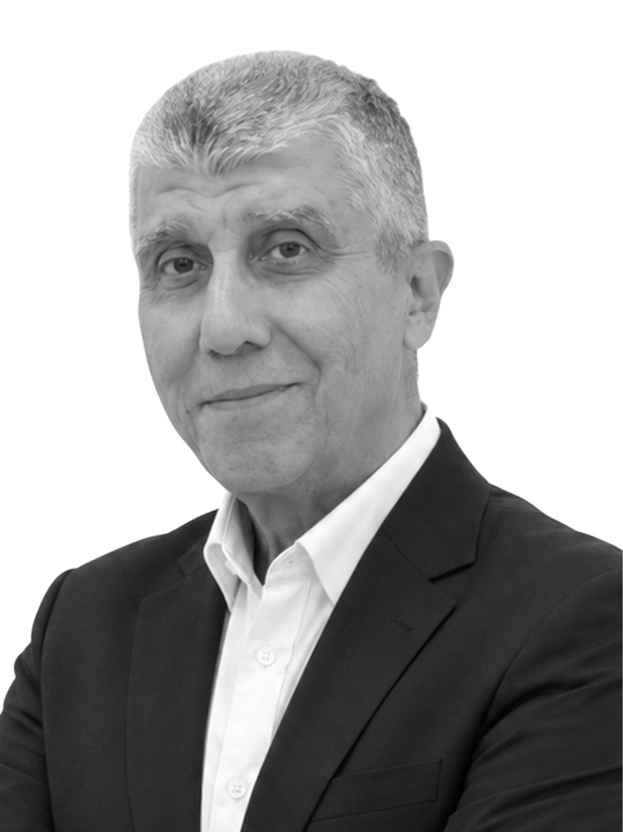
LEADERSHIP & TEAMS - Executive Committee
A unique blend of industry veterans and emerging leaders sharing a passion for BCI's slogan: A Partner for Life
Hassane Baalbaki
Karim Baalbaki
Marwan Kawas
Executive Chairman
& Group Managing Director
CEO
& Group Managing Director
Director
Group Commercial Director
With the Group since 1991.
Holds a BS in Economics and a TD from AUB, Lebanon. Attended Exec. Ed. courses at HBS, INSEAD, and AIF, among others.
With the Group since 1997.
Holds a BBA from AUB, Lebanon, and an MBA with distinction from INSEAD, France. Attended Exec. Ed. courses at HBS, Stanford, London Business School, and AIF, among others.
With the Group since 2009.
Holds a Master’s in Chemical Engineering from the University of Hamburg. Attended Exec. Ed. courses at IMD and INSEAD, France.
Ahmad Baalbaki
Wassim Bawab
Abdul-Rahman Fakhouri
Group CSO
& Managing Director, BCI Egypt
Group CFO
Managing Director
Adhesives Business Unit
With the Group since 2010.
Holds a BBA and an MBA from the LAU, Lebanon. Attended Exec. Ed. Courses at INSEAD, AIF and HBS.
With the Group since 2010.
Holds a BBA and an MBA from AUB, Lebanon. Completed a CPA from New Hampshire Board of Accountancy. Attended Exec. Ed. courses at AUB, INSEAD, and AIF.
With the group Since 2024.
Holds a B.Eng. in Mechanical Engineering from AUB, Lebanon, and an MBA from INSEAD, France.

Slide 18
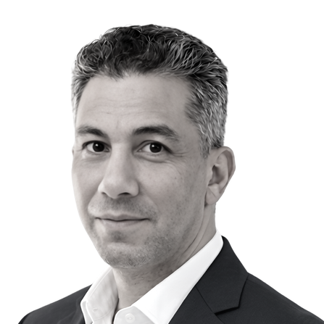
LEADERSHIP & TEAMS - Group Management Team
A unique blend of industry veterans and emerging leaders sharing a passion for BCI's slogan: A Partner for Life
Mumtaz Misrabi
Khaled Khayat
Matteo Bleynat
Managing Director
BCI Levant
Managing Director
BCI Arabia
Managing Director
BCI Europe
With the Group Since 1992.
Holds a BS in Chemistry from Damascus University, Syria. Attended Exec. Ed. courses at AUB, Lebanon.
With the Group since 1996.
Holds a BS in Chemistry from Beirut Arab University, Lebanon. Attended Exec. Ed. courses at AUB, Lebanon.
With the Group since 2020.
Holds a Diploma in Plastic
Materials from Istituto Tecnico Industriale Varese, Italy.
Mohamedali Hodeib
Fatih Karademir
Deniz Topuz
Managing Director
BCI UAE
General Manager
BCI Türkiye
Director
Business Development PU Systems Türkiye, EE and CA
With the Group since 2024.
Holds a BSc in environmental health from AUB, Lebanon; and an MBA ESCP Business School from ESA, Lebanon.
With the Group since 2024. Holds a BS in Chemical Engineering from Gazi University, Türkiye
With the Group since 2025.
Holds an M.Sc. in Polymer Science and Technology from Istanbul Technical University, Türkiye.
Badih Hokayem
Asaad Imad
Ahmad Bayan
General Manager
BCI Nigeria
Executive Manager
Iraq
Head of Strategy
& Chief of Staff
With the Group since 2025.
Holds a BS in Agricultural Engineering from USEK, Lebanon; and a minor in environmental resource management from Brandenburg University of Technology, Germany.
With the Group since 2021.
Holds a BS in in Business Computing from NDU, Lebanon and an EMBA from LAU, Lebanon.
With the Group since 2024
Holds a BA in Business and Knowledge Management from Multimedia University, Malaysia and an MBA from INSEAD, France.

Slide 19
LEADERSHIP & TEAMS - Group Management Team
A unique blend of industry veterans and emerging leaders sharing a passion for BCI's slogan: A Partner for Life
Rula Jubayli
Abdallah Makhoul
Ohans Iskanian
Senior Manager
Business Development
& Key Accounts
Senior Manager
Human Resources
Senior Manager
Engineering & Capex
With the Group since 2012.
Holds a BS in Marketing and Management from LAU, Lebanon.
With the Group since 2016.
Holds a BA in Human Resources from Sydney University, Australia. Attended Exec. Ed. courses at AIF
With the Group since 2007.
Holds a M.Sc. in industrial Electronics, from National Polytechnic University, Armenia.
Antonio Mainolfi
Ronnie Arjona
Bachir Frem
Senior Manager
Technical Operations
BCI Europe
Senior Manager
R&D
Senior Manager
Procurement
With the Group since 2016
Holds a Diploma in Chemistry, Materials Science, and Biotechnology from Istituto Tecnico Industriale Varese, Italy.
With the Group since 2006.
Holds a BS in Chemical Engineering from Colegio San Agustin-Bacolod, Philippines.
With the Group since 2014.
Holds an MBA from Sagesse University, Lebanon.
Attended Exec. Ed. courses at AIF
Karim Shalaby
Hadi Najjar
Isabelle Mansour
Senior Manager
Business Planning & Control
Senior Manager
Central Finance & Treasury
Senior Manager
Sustainability, Marketing & Communications
With the Group since 2014
Holds a BBA in Accounting and Finance from Cairo University, Egypt, and an MBA from AUC.
With the Group since 2010
Holds a BSc in Banking and Finance from the Lebanese University, Lebanon.
With the Group since 2024.
Holds a BBA from JCU, Italy and an Executive Diploma from IMD, Switzerland.

Slide 20
GOVERNANCE & STRUCTURE - Supervisory Board
Renowned industry leaders setting the benchmark for best in-class corporate governance
Ihsan O. Baalbaki
José Luis Müller
Group Chairman
With unique vision, strong determination, and a distinctive entrepreneurial drive, Dr. Baalbaki has built and scaled more than 70 successful businesses over a career spanning more than seven decades. Following the nationalization of the family’s businesses in Syria in 1964, he moved permanently to Beirut, where he established a leading regional conglomerate spanning industry, trade, agriculture, real estate development, and financial institutions.
Dr. Baalbaki steered the Group toward sustained prosperity while withstanding multiple nationalizations, currency devaluations, and revolutions. A strong advocate for industrial employment and inclusive finance, he developed one of the Levant’s largest private industrial zones, participated in launching one of Lebanon’s first investment banks, and was a founding shareholder of Syria’s first privately owned commercial bank.
Dr. Baalbaki holds a PhD and an MA in Economic Development from Stanford University and a BA in Economics from AUB. He received the Queen Elizabeth II Award for Export Development and the Norwegian Export Council Award from the Kingdom of Norway.
José Luis built a strong foundation in the polyurethanes industry from 1991 to 2005 at Bayer in Spain and Germany, covering production, technical support, and sales for automotive and insulation markets. He later launched the TPU Business Unit at Merquinsa, leading its global expansion into the US and China.
From 2005 to 2018, he held senior leadership roles at Synthesia and Morchem, overseeing global growth, operational excellence, and establishing subsidiaries in the US, UAE, China, and India.
From 2018 to 2024, as CEO of GRIT, he expanded market presence and executed a private-equity-led transition. José Luis holds a Chemical Engineering degree from IQS Barcelona and an MBA from ESADE.
Zuhair I. Baalbaki
Uwe Hartwig
Zuhair Baalbaki brings over 40 years of experience in industry, trade, and real estate development. He currently leads the Group’s real estate investments and oversees its Relief Supplies and Emergency Aid business.
He played a key role in rebuilding the Group’s operations in Syria between 1986 and 2011 and earlier led its expansion into the HVAC sector.
Zuhair is deeply engaged in the Ihsan Baalbaki Charitable Foundation and was recognized when Forbes Magazine ranked the Group among the “Top 50 Groups in the Arab World Making a Positive Impact” in 2012.
He holds an MBA and BBA from the American University of Beirut and completed the Harvard Business School OPM Program. He also attended executive education programs at Harvard, INSEAD, and the Amsterdam Institute of Finance.
From 1988 to 2001, Dr. H held key roles at BASF in R&D, marketing, sales and site management, including PU development, automotive PU sales, and global research coatings.
Between 2001 and 2013, he served as Group VP and later Senior VP, leading global marketing and strategic development for BASF Polyurethanes and serving on its Executive Board.
From 2013 to 2019, Uwe held SVP roles in global marketing and strategic marketing & research for BASF Care Chemicals. Since 2019, he has been a consultant with Boston Consulting Group. Dr. Hartwig holds a PhD in Chemistry from Heidelberg University and also studied Philosophy.

Slide 21
GOVERNANCE & STRUCTURE
100% | 100% | 100% | 100% | 90% | 100% | 100% | 100%
BCI International FZE (Hamriya Freezone, UAE) | Baalbaki Chemical Industries LLC (Dubai Industrial City, UAE) | Baalbaki Egypt For Chemical Industries S.A.E (Egypt) | BCI Arabia LLC (KSA) | Urethane Holdings Limited (Malta) | BCI Baalbaki Kimya San. ve Tic. A.S. (Türkiye) | Baalbaki Chemical Industries BCI Nigeria LTD (Nigeria) | Avalon Chemicals LLC (Jordan)
A transparent and clear legal structure with HQ in the Dubai International Financial Center (DIFC)
 |  |  | UNIMETCO Holdings LTD (DIFC, Dubai-UAE)
 |  |  | 100%
 |  |  | BCI Holding SA. (BVI) |  | BCI Holding SA. Rep Office (Lebanon)
100% | 100% | 100% | 100% | 90% | 100% | 100% | 100%
BCI International FZE (Hamriya Freezone, UAE) | Baalbaki Chemical Industries LLC (Dubai Industrial City, UAE) | Baalbaki Egypt For Chemical Industries S.A.E (Egypt) | BCI Arabia LLC (KSA) | Urethane Holdings Limited (Malta) | BCI Baalbaki Kimya San. ve Tic. A.S. (Türkiye) | Baalbaki Chemical Industries BCI Nigeria LTD (Nigeria) | Avalon Chemicals LLC (Jordan)
 |  | 100% |  | 70..3%
 |  | BCI Egypt Rep Office (Lebanon) |  | BCI Polyurethane Europe S.r.l. (Italy)

Slide 22
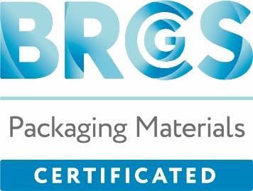







STANDARDS & CERTIFICATIONS
Driving responsible, customer-centric growth with global standards
Certified to International ISO Standards
ISO 9001
ISO 14001
ISO 45001
Certifies our commitment to consistent quality, customer satisfaction, and continual improvement.
Confirms our responsibility to manage environmental impact and promote sustainability.
Ensures a safe and healthy workplace by minimizing risks and protecting people.
Guarantees that packaging is safe for human health, protective throughout its lifecycle, and provides clear information to end users.
Reflects our commitment to waste reduction, recycling, and responsible resource use.
Confirms our commitment to sustainable practices, ethical sourcing, and supply chain integrity.
Products tested and approved for use where fire safety is critical.
Supports recyclable packaging design and reflects our commitment to circularity and responsible material choices
Energy-Efficient Manufacturing Systems
Signature Technology
Fully automated production lines with SCADA systems achieving:
Proprietary technology converting post-consumer PET into polyester polyol for insulation applications:
Real-time process data monitoring and data logging for analysis, troubleshooting, and optimization.
Supporting circular economy goals and reducing reliance on virgin materials, minimizing waste and environmental impact.

Slide 23
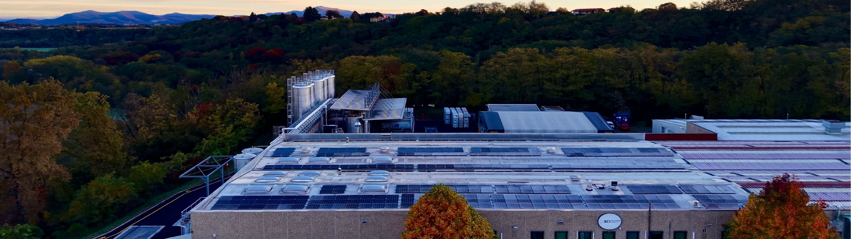
Our strategy is simple: Remain geographically and strategically close to customers; value relationships before transactions; maintain product, people and approach consistency; and foster responsible entrepreneurship and partnerships. This creates a unique value proposition for customers, suppliers and stakeholders at large and the confidence that they can rely on BCI as their Partner for Life.
Dr. Ihsan Baalbaki
Group Chairman

